Slide 1
Data Driven AI
L1- Week 10 – Optimising CNN Models
Dr. Abirami Gunasekaran
CHS2406: Data-driven AI

Slide 2
Topics
Optimising a CNN Model
Data Augmentation
A Practical example - optimise CNN model’s performance

Slide 3

Optimising a CNN Model Performance
1. Data Augmentation
2. Add More Layers
3. Optimise Hyperparameters
4. Use Advanced Optimisers
5. Transfer Learning

Slide 4
Data Augmentation
What is Data Augmentation?
Why do we need it?
How does data augmentation work?
What to Augment?
Augmentation Categories for Images
Where and when to use Data augmentation?

Slide 5
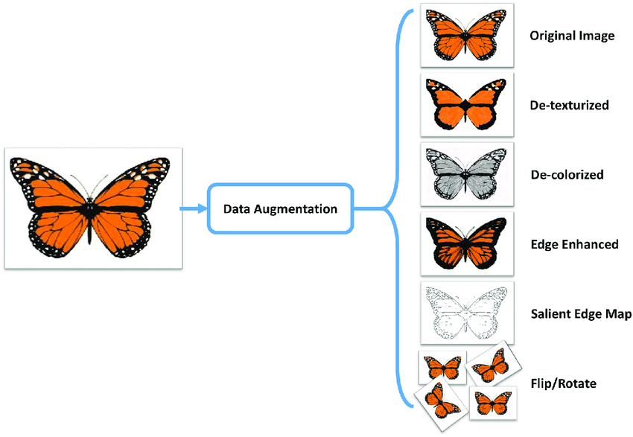
SEMINAR WEB ENGINEERING (WS 2020/2021) DATA AUGMENTATION
What is Data Augmentation?
Expand the size of a training set
by creating modified data from
the existing one.
- Significantly increases the diversity of data
available for training our models, without actually
collecting new data samples.

Slide 6
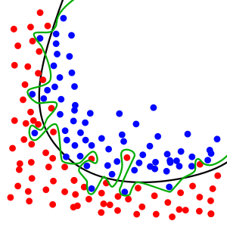


Purpose of Data Augmentation
Enlarge dataset
Prevent overfitting
Improve performance model

Slide 7
Data Augmentation Advantages
Reduce overfitting
You don’t want the network to memorize the features of training data.
Faster training
Increased accuracy
Increased dataset size
Makes your trained neural network invariant to different aspects
Translation
Size
Illumination
Location
Mask
Add hard-to-get or rare variations to the dataset

Slide 8



SEMINAR WEB ENGINEERING (WS 2020/2021) DATA AUGMENTATION
What to Augment!
Audio
Texts
Images
Any other
types

Slide 9
SEMINAR WEB ENGINEERING (WS 2020/2021) DATA AUGMENTATION
Data Augmentation techniques : For Text
In my presentation focus topic is Data Augmentation.
In my presentation theme topic is Data Augmentation -- Synonym Replacement
In my presentation focus topic is Data Augmentation techniques -- Random Insertion
In my presentation topic focus is Data Augmentation -- Random Swap
In my presentation focus topic Data Augmentation --Random Deletion

Slide 10
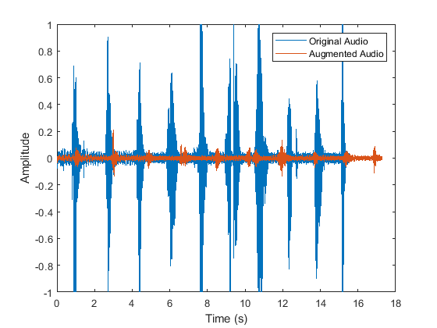
SEMINAR WEB ENGINEERING (WS 2020/2021) DATA AUGMENTATION
Data Augmentation techniques : For Audio
Noise Injection
Shifting
Changing the speed of the Tape

Slide 11
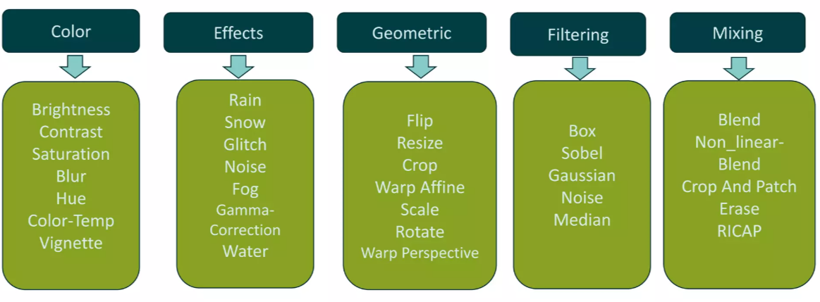
Data Augmentation Categories for Images

Slide 12
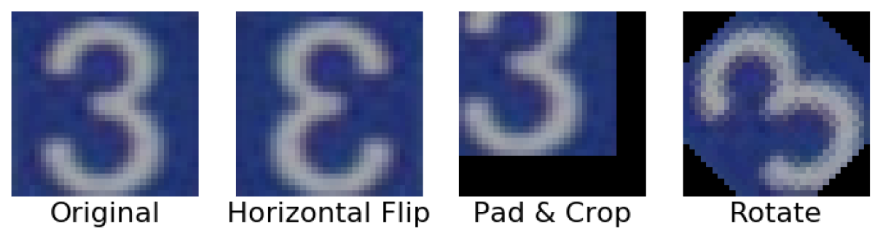
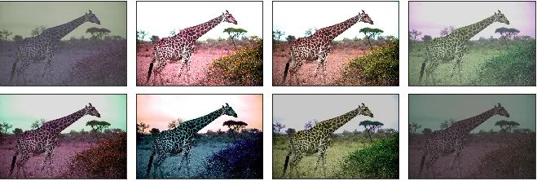

SEMINAR WEB ENGINEERING (WS 2020/2021) DATA AUGMENTATION
Data Augmentation techniques : For Images
Geometric transformations
Color space transformations
Mixing images

Slide 13
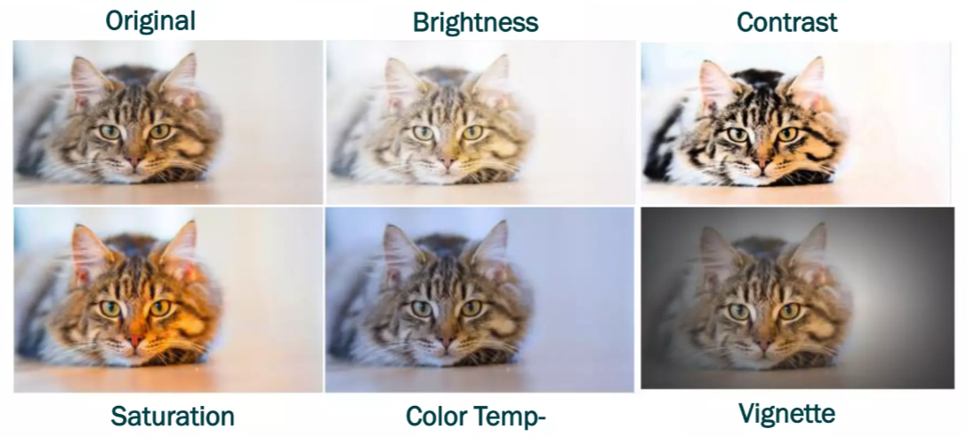
Colour & Illumination Examples

Slide 14
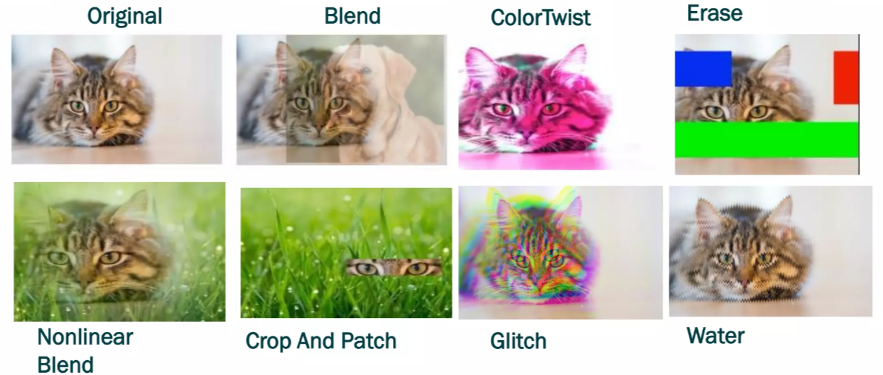
Mixing Augmentations: Disruptive

Slide 15
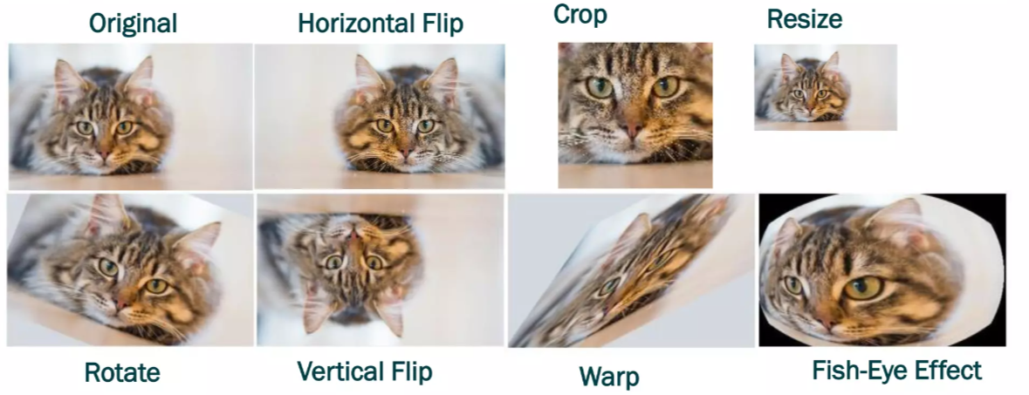
Geometric & Displacement Distortion Examples

Slide 16

Image Flipping
Horizontal Flip
Vertical Flip

Slide 17

Image Rotation
90⁰
45⁰
135⁰
0⁰
180⁰
315⁰
225⁰
270⁰

Slide 18






Zooming

Slide 19
Width and Height Shift

Slide 20
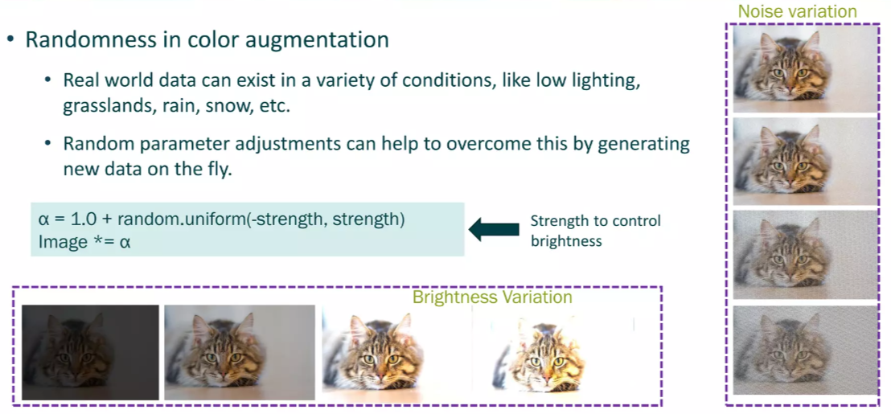
Random Parameter Adjustments to Prevent Overfitting

Slide 21
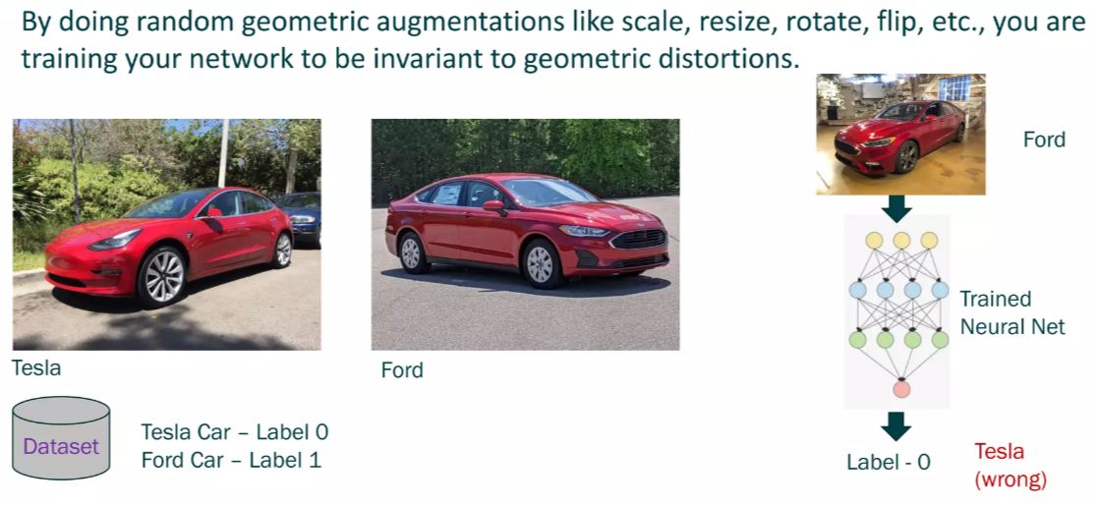
Random Geometric Distortion

Slide 22
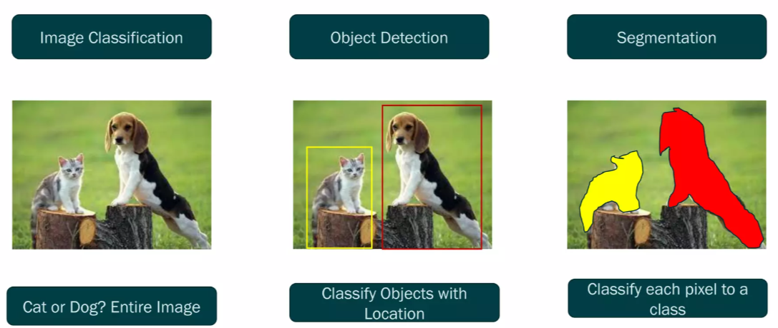
Different Use cases for Augmentations

Slide 23
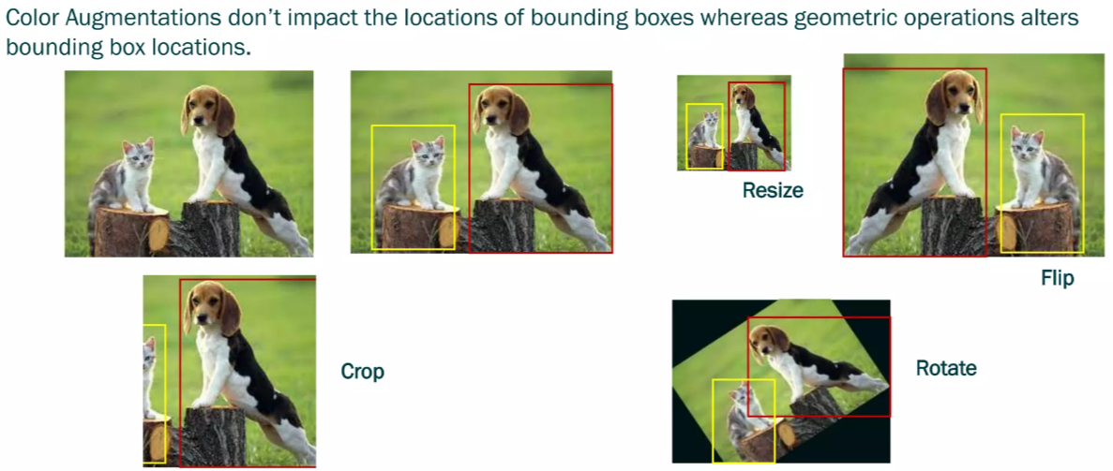
Bounding box Augmentations

Slide 24
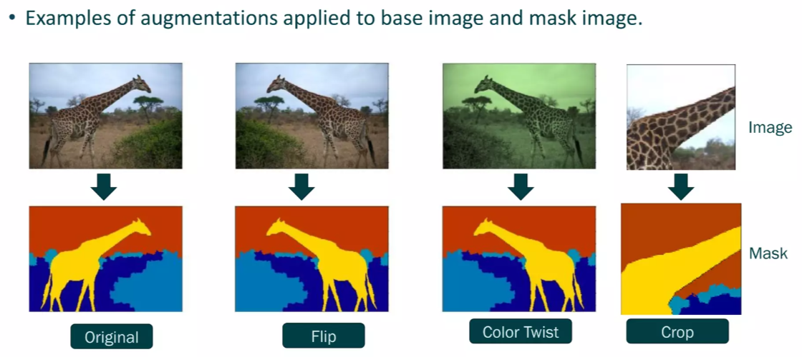
Segmantation Mask Augmentations

Slide 25



SEMINAR WEB ENGINEERING (WS 2020/2021) DATA AUGMENTATION
Workflow of Data Augmentation
Data set
Training set
Validation set
Data Augmentation
Enlarged training set
Performance test
and evaluation

Slide 26



SEMINAR WEB ENGINEERING (WS 2020/2021) DATA AUGMENTATION
When do I use data augmentation?
small data set
complex problem
transformation of data would be effective and easy
You know how to find the correct method for your data
You have a strategy for dealing with overfitting

Slide 27

Data Augmentation Applications
Natural Language Processing
Image classification
Speech recognition, sound classification
text classification, text generation
Scientific research, medical fields
Human-computer interaction, Understanding human emotion

Slide 28
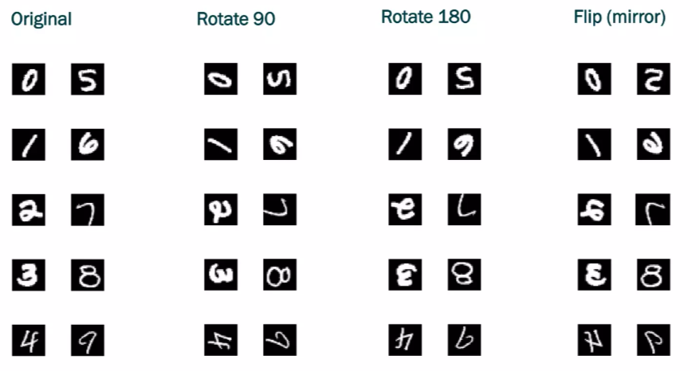
Not All Augmentations Apply to All Datasets

Slide 29
Optimising a CNN Model Performance A Programming Example

Slide 30
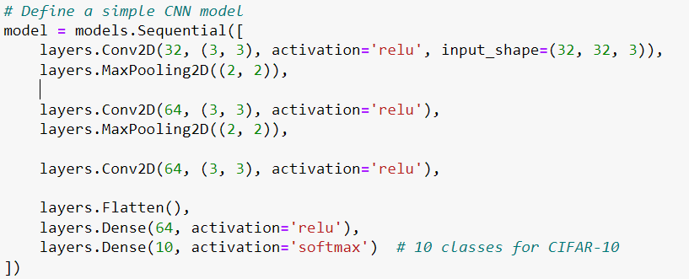
CNN Model on CIFAR10 Image Dataset

Slide 31
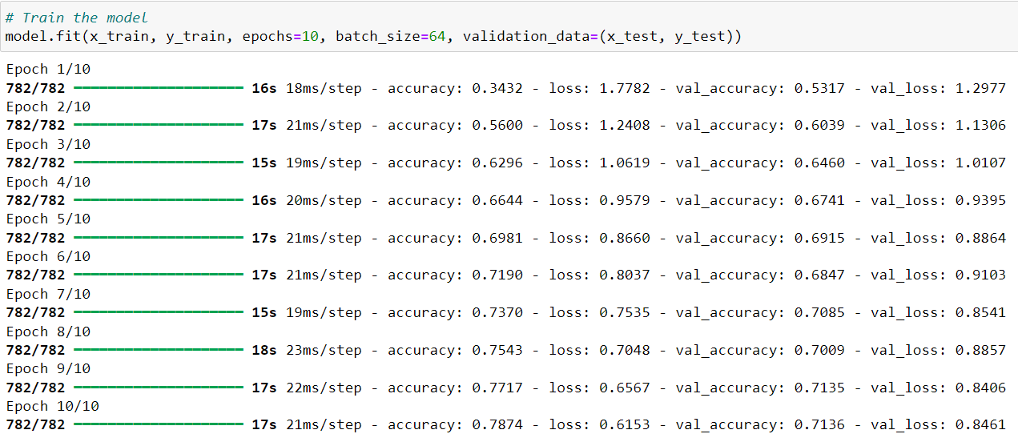
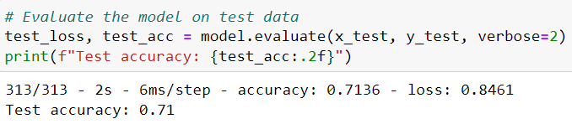

Slide 32
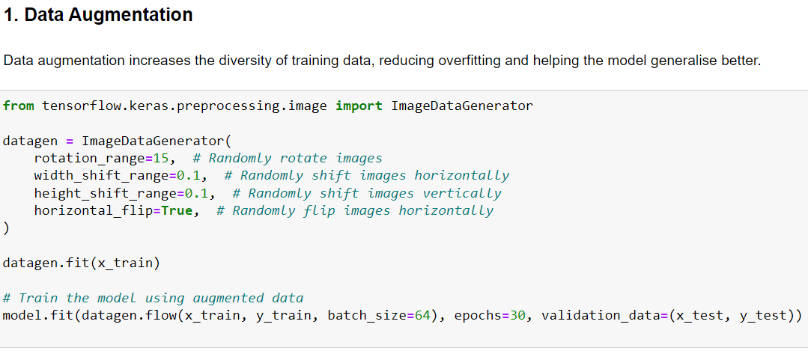
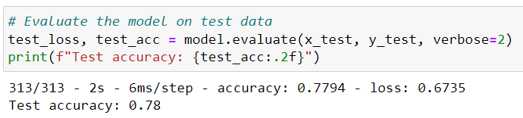

Slide 33
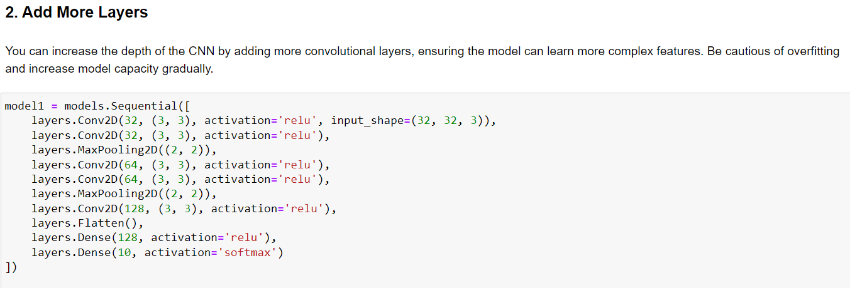

Slide 34
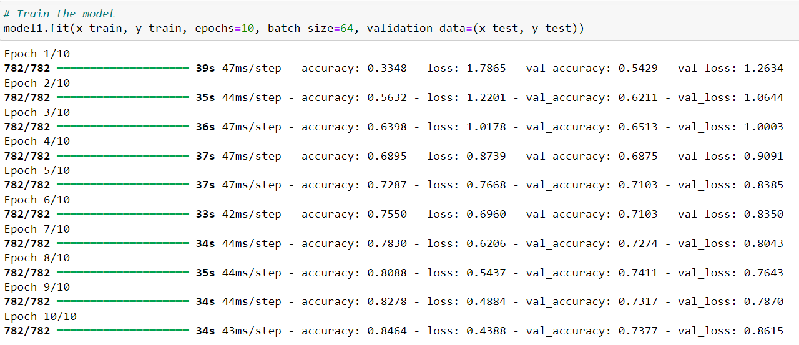
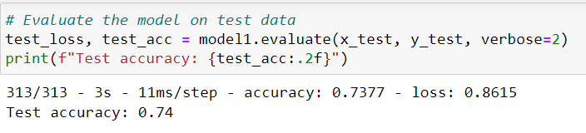

Slide 35
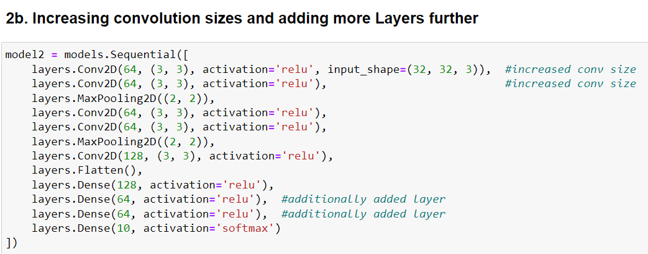

Slide 36
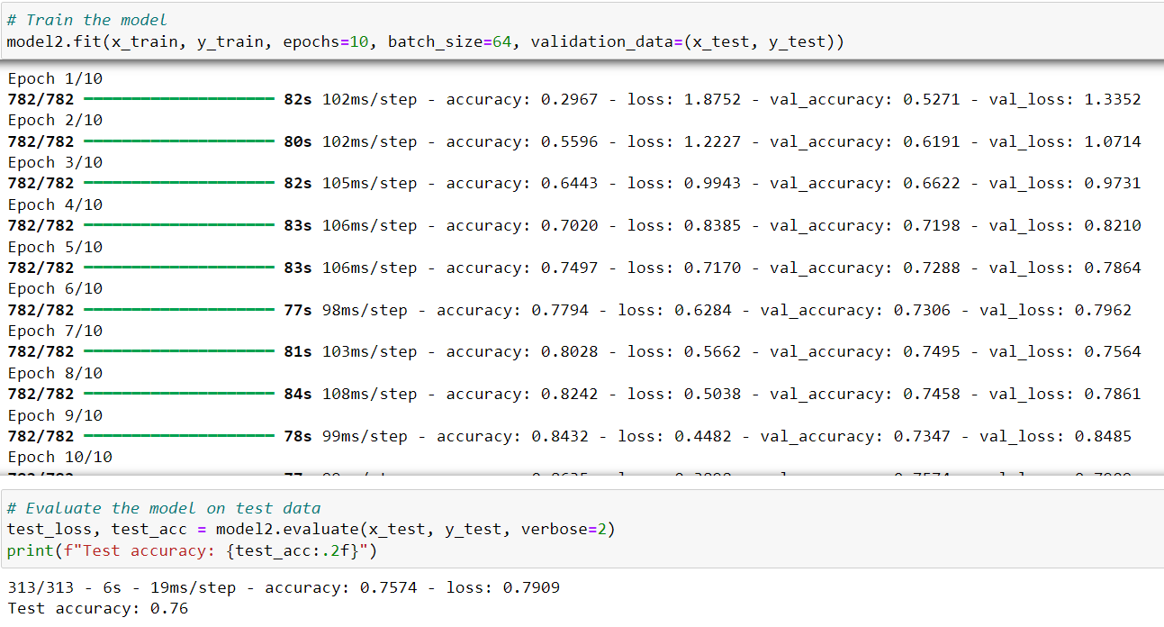

Slide 37
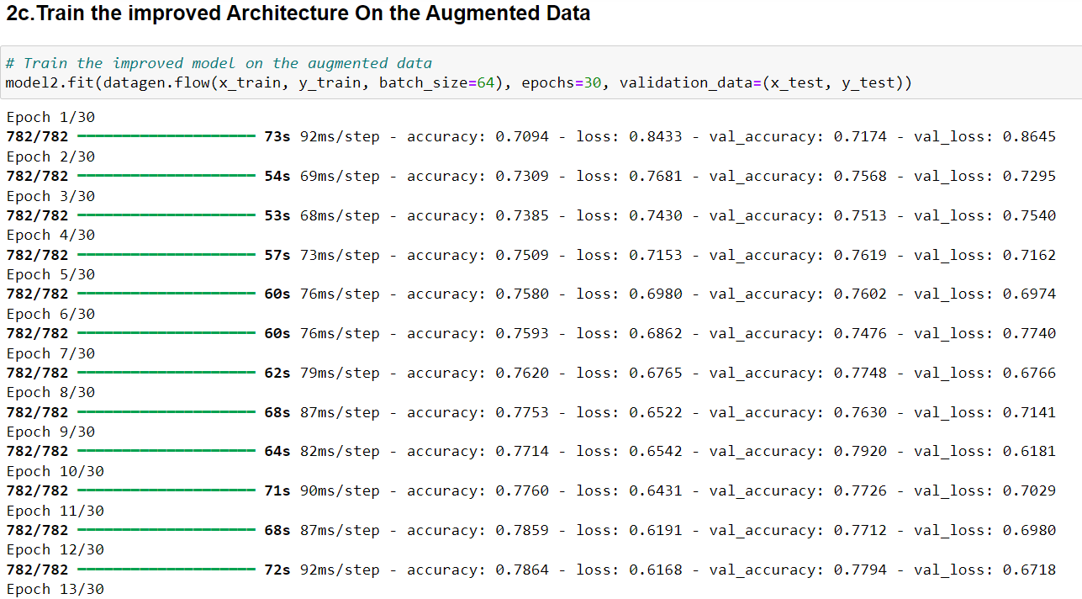

Slide 38
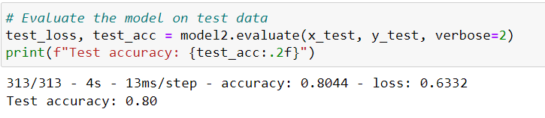
Optimised Accuracy
Base Accuracy
Repeat increasing no. of filters in convolutional layers and/or no. of convolutional layers
&
Retrain the model

Slide 39
Any Questions?
Sources for reference:
https://www.slideshare.net/slideshow/data-augmentation-251429872/251429872
https://www.slideshare.net/slideshow/an-introduction-to-data-augmentation-techniques-in-ml-frameworks-a-presentation-from-amd/250110127#9

